Slide 1

Prediction of Consumer Disputes about Financial Complaints Response
Team 2 Members:
Fengmei Liu, Xiaoyan Chong and Weiqian Hou

Slide 2
Outline
Introduction and motivation
System Design & Implementation details
Experiments of concept evaluation
Data Preprocessing
Logistic regression
Naive Bayes
Gradient Boosting Tree
Conclusion and Discussion

Slide 3

Problem to Solve
US Consumer Finance Complaints Dataset
YEAR 2016, Data Size 50853
INPUT
date_received
Product, sub_product
Issue, Sub_issue
Consumer_complaint_narrative
Company_public_response, Company
State, zipcode, tags
Consumer_consent_provided
Submitted_via, date_sent_to_company
Company_response_to_consumer
timely_response
complaint_id
All Catogorical
Data
Kaggle dataset “US Consumer Finance Complaints”.
Background
Consumer Financial Protection Bureau (CFPB) sends consumers’ complaints about financial products/services to companies for response
Objective
Classification: Consumer Disputed(YES/NO) from a knowledge of complaint patterns.
Meaning
Use as a reference for companies to understand their customer service
Guide customers to follow the correct way of feedback to get complains successively solved
OUTPUT
Consumer_disputed (Yes/No)
Two Levels

Slide 4
System Design and Process Flow
Training Data
Implement Algorithms
Tune parameters
Read Data
Data Exploration
Data Cleaning
Test Data
Prediction
Build Models
Evaluation
Final Model
Compare Classifiers
Evaluation

Slide 5
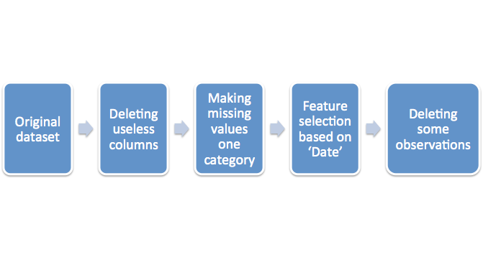
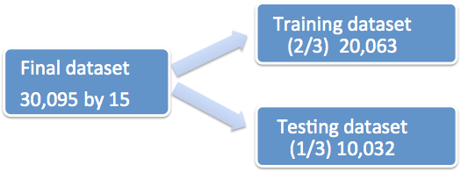
Data Preprocessing

Slide 6
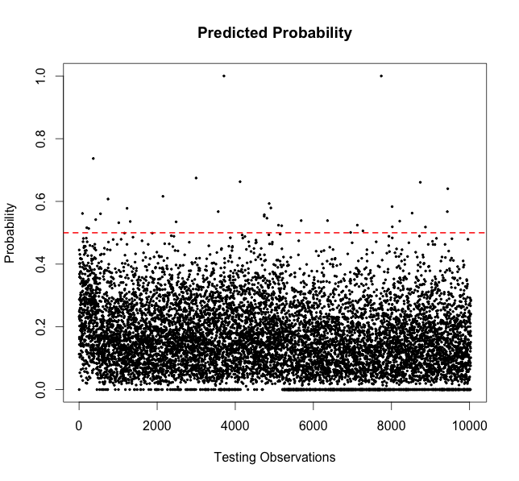
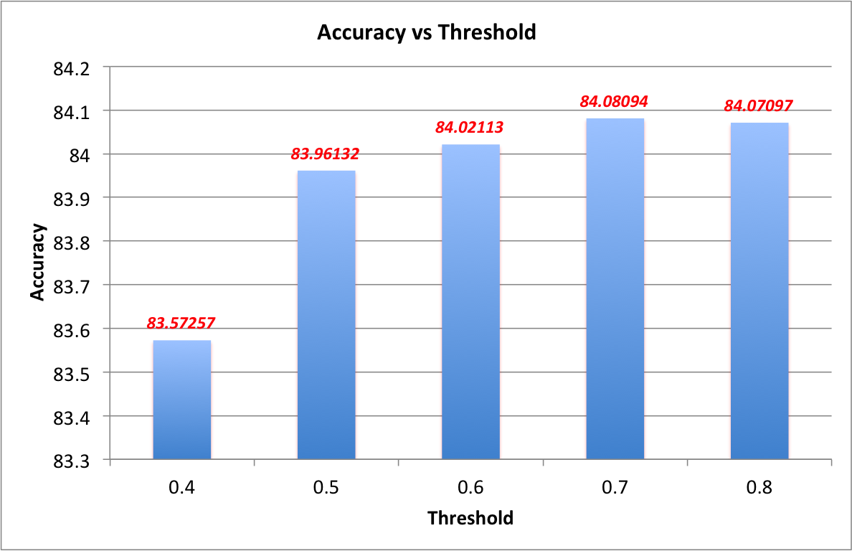
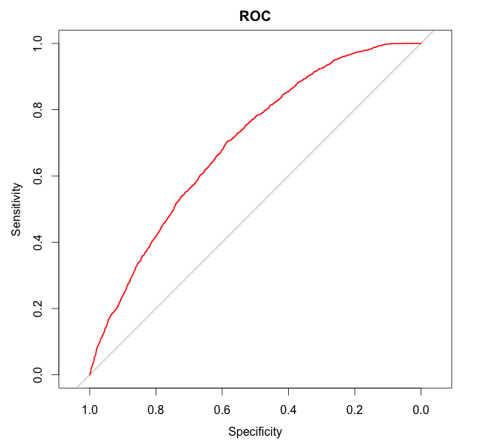
Logistic Regression
AREA under the curve is: 0.6963
Reason?

Slide 7
Logistic Regression
Pros:
fast and intrinsically simple
low variance and so is less prone to overfitting
Cons:
Doesn’t handle large number of categorical variables well
Does not give us much space to improve the final predicting accuracy.

Slide 8
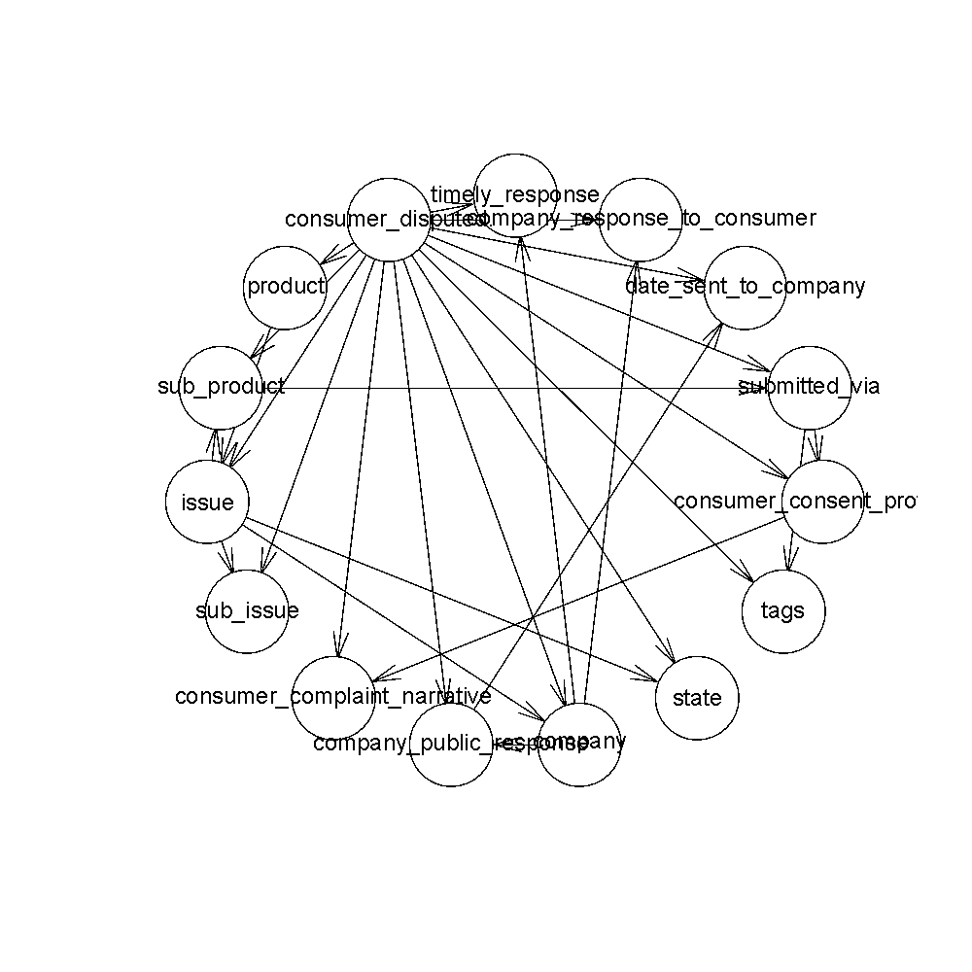
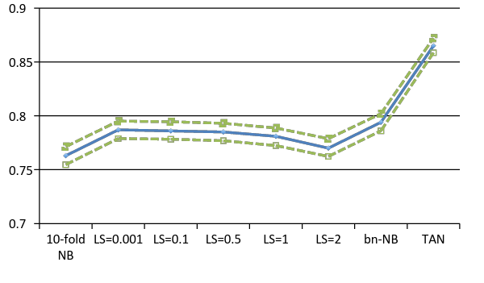
Naïve Bayes & Tree Augmented Naïve Bayes(TAN)
Models
Simple Naïve Bayes, Cross Validation 10-fold
Laplace Smoothing ( 0.001, 0.1, 0.5, 1,2),
Cross Validation 10-fold
TAN
Result
TAN has the best accuracy 0.865 and Narrowest 95% C.I.
Laplace smoothing has no improve as the test data
has no new categories.
Run Result: TAN model shows the correlation between inputs and output

Slide 9
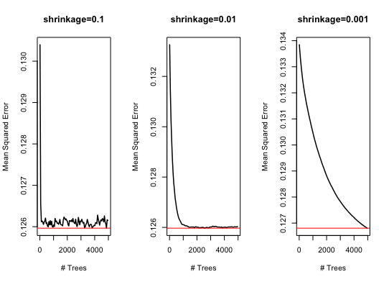
Decision Tree (Gradient Boosting)

Slide 10
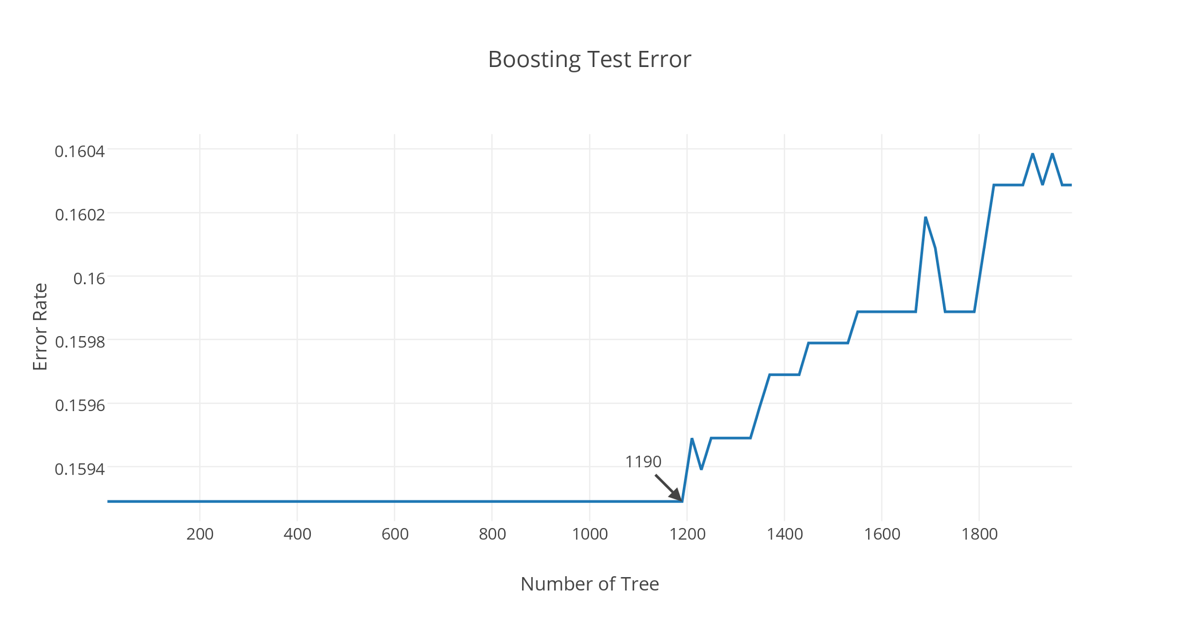
Decision Tree (Gradient Boosting)

Slide 11
Gradient Boosting Tree
Pros:
Yields a very accurate classifier.
Faster than other boosting methods such as adaptive boosting.
Cons:
Hard to tune the model due to so many parameters.
Easy to get overfitting.
Not very speedy.

Slide 12
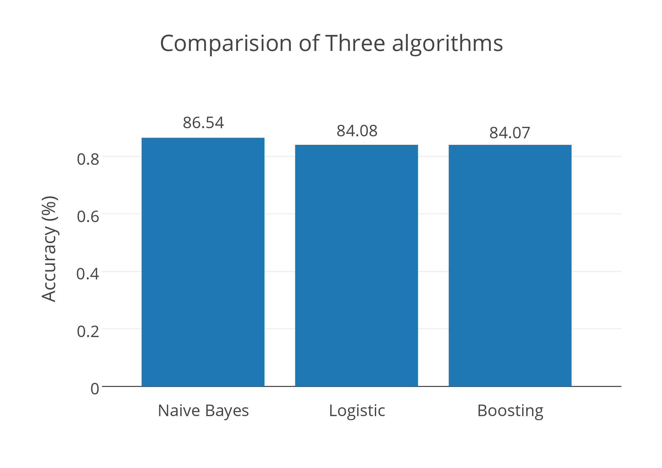
Comparison of Three Algorithms

Slide 13
Thank you

